Slide 1
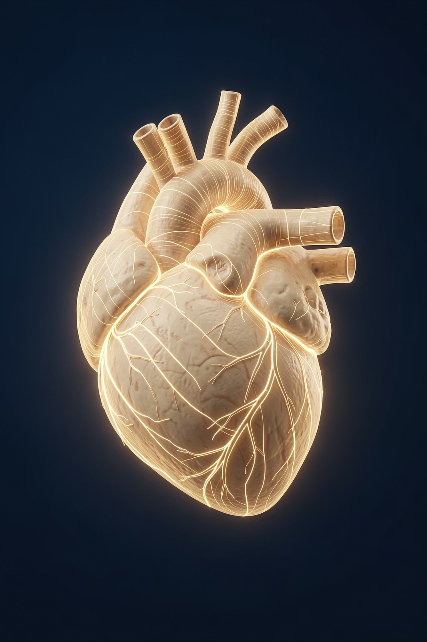
Heart Disease Prediction using Machine Learning

Slide 2

Introduction: Understanding the Threat
Heart disease affects millions of people every year and remains a major global health problem.
Early detection is very important because it can save lives and improve treatment outcomes.
Machine Learning helps doctors predict heart disease more quickly and accurately.

Slide 3

The Problem: A Growing Challenge
Rising Prevalence
Slow Diagnosis
Heart disease cases are steadily increasing worldwide, posing a significant public health burden.
Traditional diagnostic methods can be time-consuming, delaying critical interventions.
Urgent Need
ML to the Rescue
A rapid and reliable prediction system is essential to support clinicians and save lives.
Machine Learning offers a powerful approach to automate and expedite risk assessment.

Slide 4

Project Objective: Empowering Prediction
Predict Heart Disease
Utilize Medical Data
Compare ML Models
Enhance Early Detection
This project aims to develop a robust system for early heart disease prediction, leveraging comprehensive medical datasets and comparing the efficacy of different machine learning models.

Slide 5
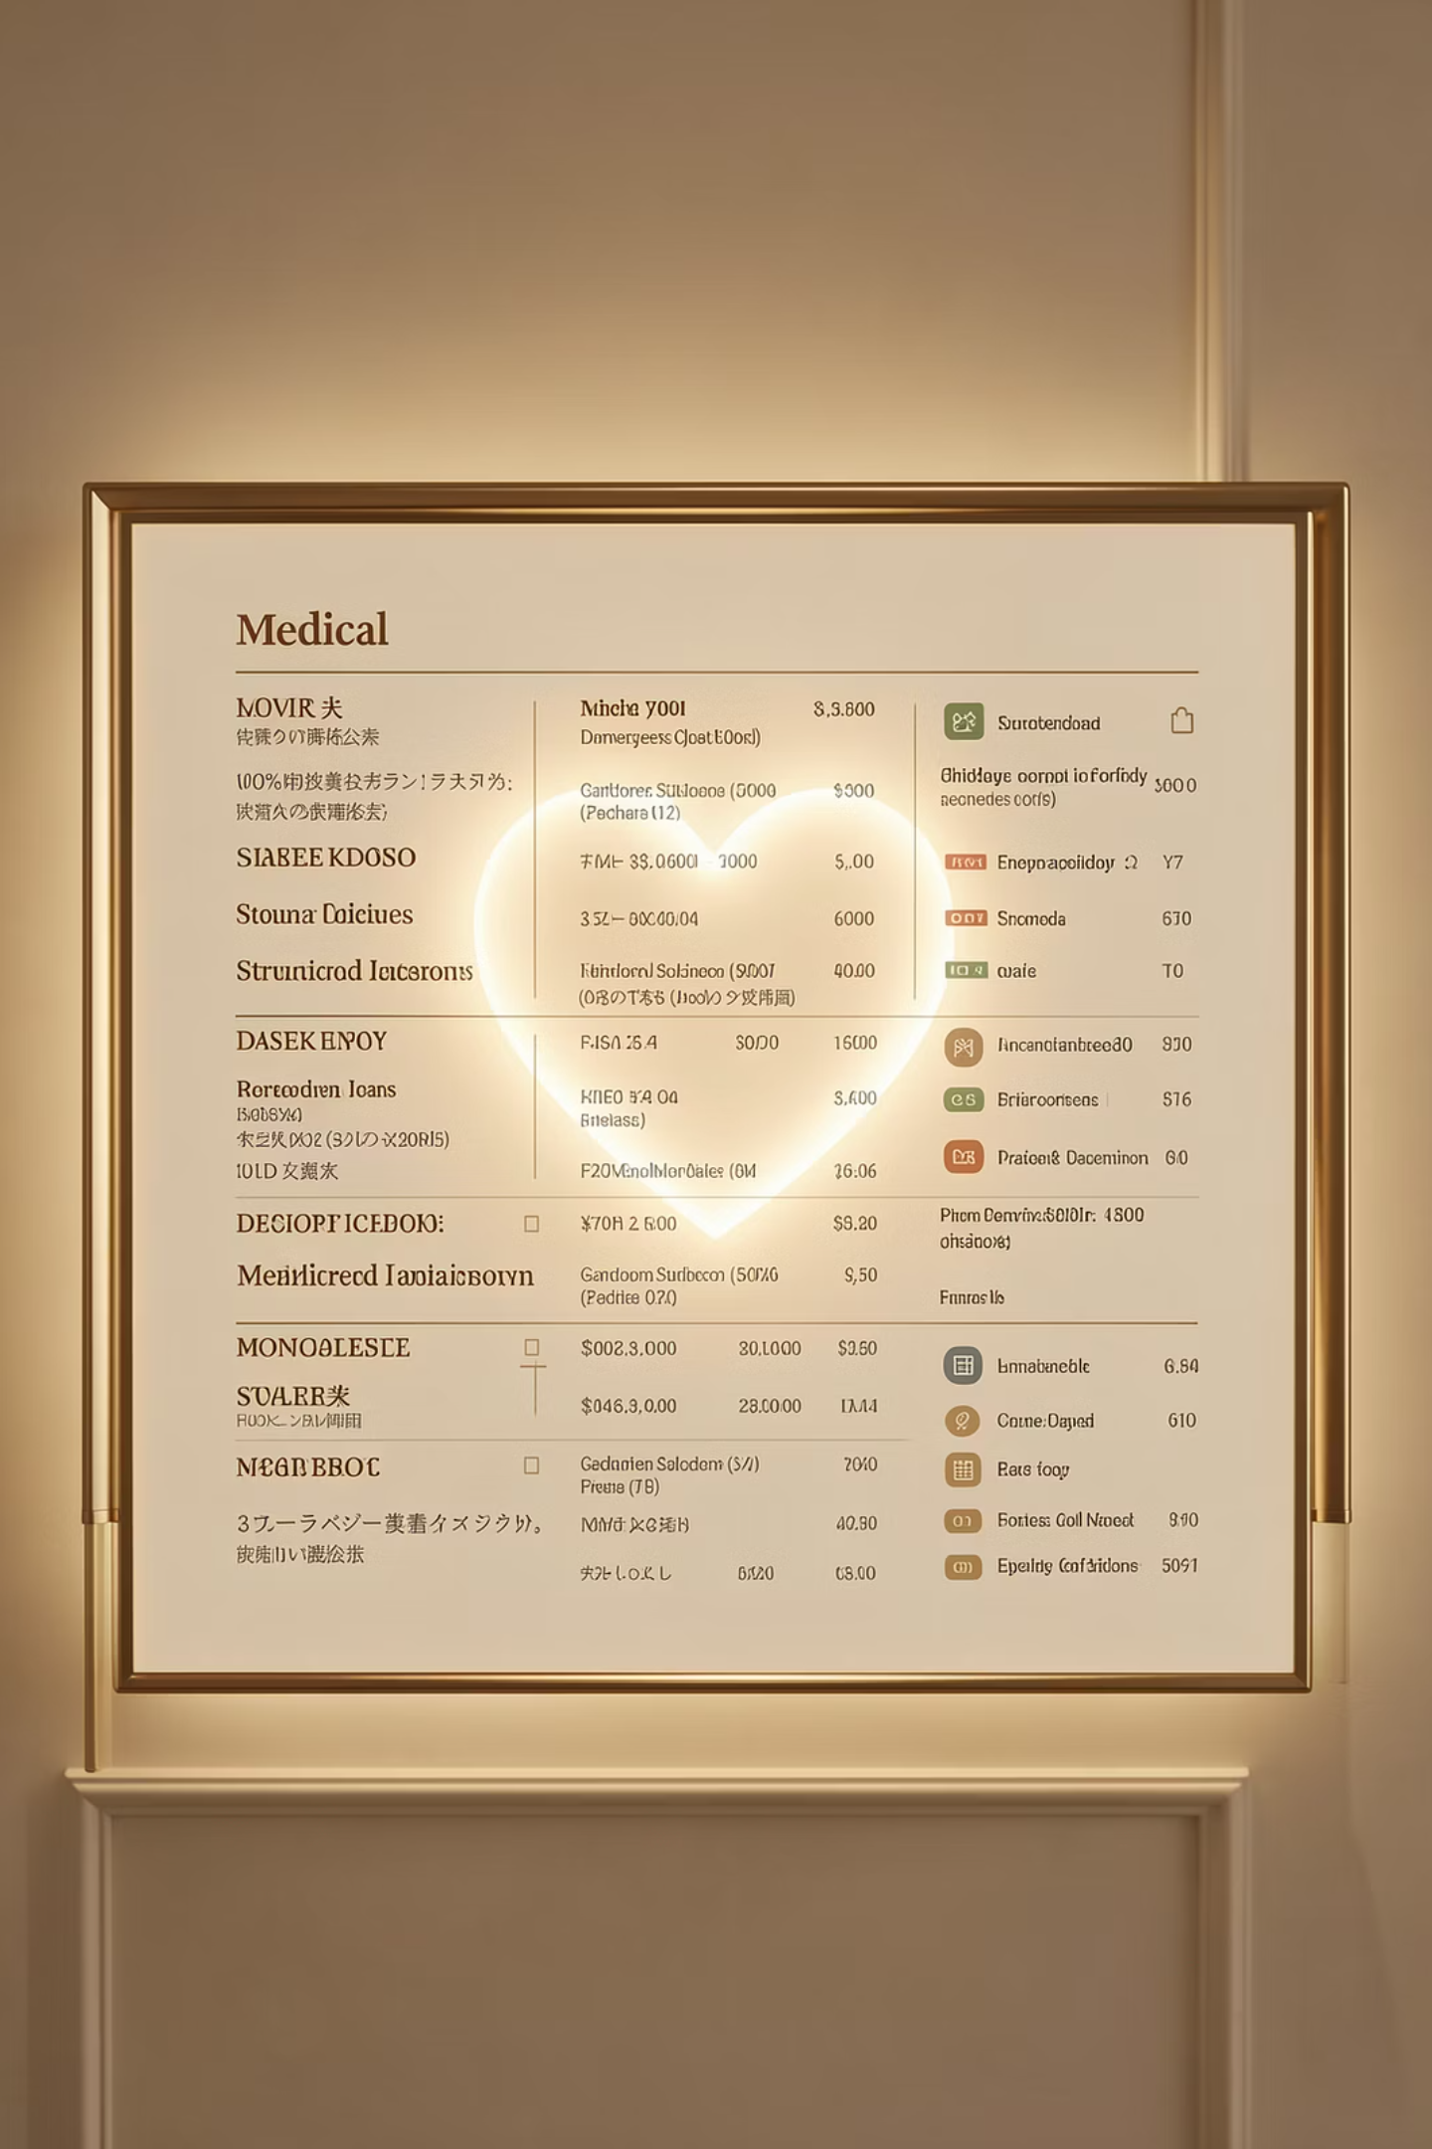

Dataset Overview: Real-World Insights
Our analysis is based on a Kaggle Heart Disease Dataset, comprising diverse medical attributes from real patients.
The target variable indicates the presence (1) or absence (0) of heart disease.
Key features include:
This dataset provides a strong foundation for building accurate predictive models due to its real-world origin and comprehensive features.
Age, Gender
Chest Pain Type (cp)
Cholesterol (chol)
Resting Blood Pressure (trestbps)
And many more...

Slide 6
Data Preprocessing: Preparing for Intelligence
Data Cleaning
Train-Test Split
Addressing missing values and outliers to ensure data quality and model reliability.
Dividing the dataset into 80% for training and 20% for rigorous model evaluation.
Feature Scaling
Model Readiness
Normalizing feature ranges to prevent dominance by variables with larger values.
Final preparation of the data for optimal performance with our chosen ML algorithms.

Slide 7

Model 1: Logistic Regression
Logistic Regression is a powerful statistical model for binary classification tasks.
It employs a sigmoid function to map predictions to probabilities between 0 and 1.
Highly effective for medical prognoses due to its interpretability and ability to handle large datasets.

Slide 8
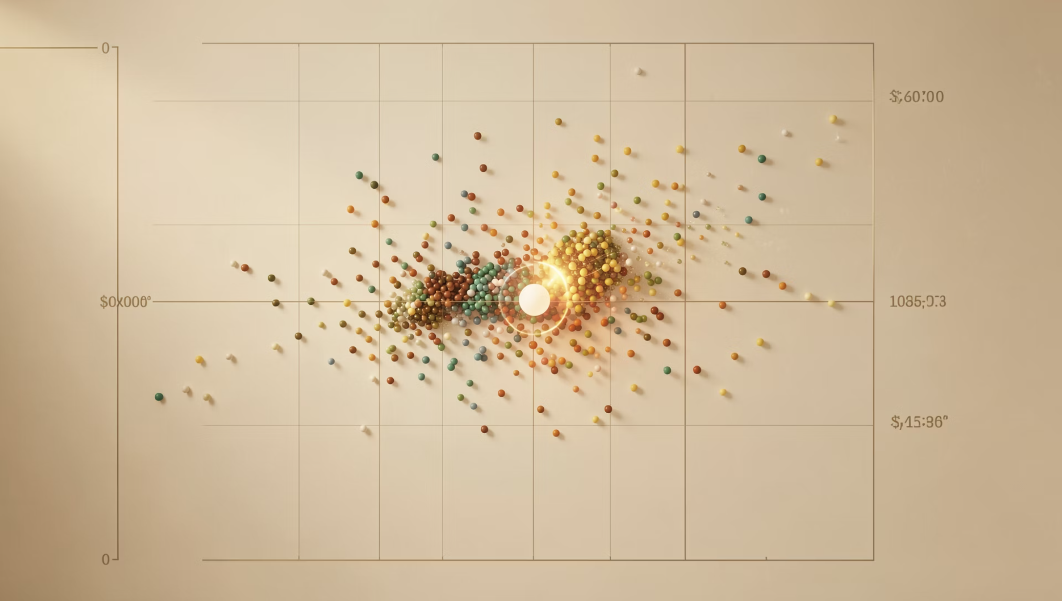
Model 2: K-Nearest Neighbors (KNN)
KNN is a simple machine learning algorithm used for classification. It does not make assumptions about the data.
It predicts a class by checking the nearest data points and choosing the majority.
Feature scaling is important because KNN uses distance to make predictions.

Slide 9
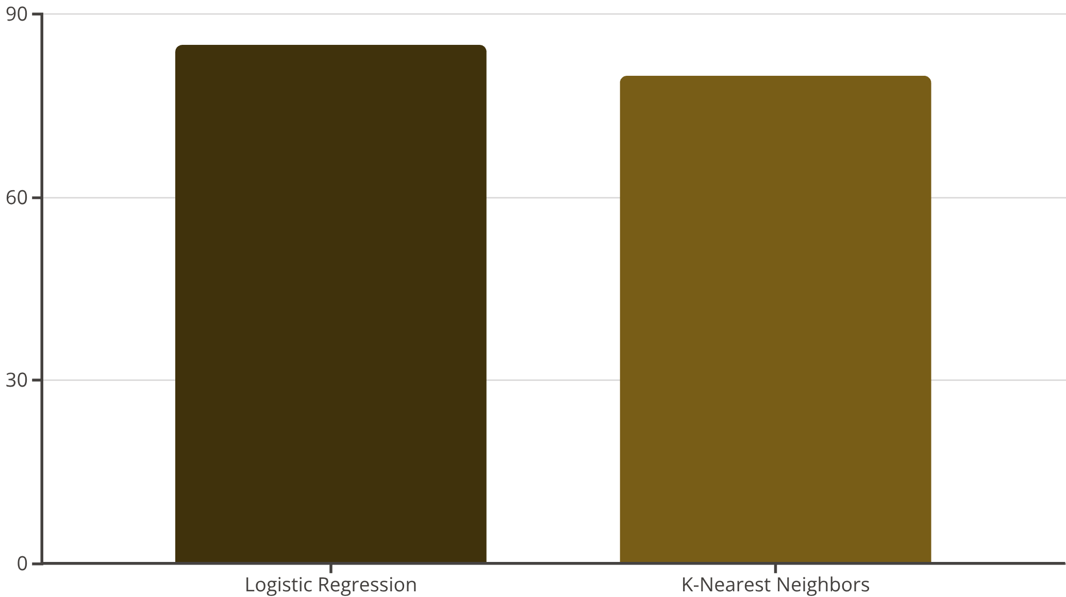
Comparative Results: Model Performance
Our evaluation revealed that Logistic Regression achieved a higher accuracy of approximately 85%.
The KNN model also performed commendably, with an accuracy of around 80%.
These results demonstrate good predictive performance, with Logistic Regression proving marginally superior for this dataset.

Slide 10

Conclusion & Future Vision
Enhanced Detection
Clinical Support
Continuous Improvement
Machine Learning significantly aids in the early detection of heart disease.
These models serve as valuable tools to support medical professionals.
Accuracy can further improve with larger and more diverse datasets.
Future:
Web App Deployment
Making your ML model usable through a website for everyone

Slide 11
Thank You!

